Slide 1
Machine Learning & Dating
Sunghwan Kim
01/08/2019

Slide 2
Table of Contents
Dataset Exploration
Question Formulation
Augmentation Normalization
Classification Approaches
Regression Approaches
Conclusion/Next Steps

Slide 3
Data Exploration~

Slide 4
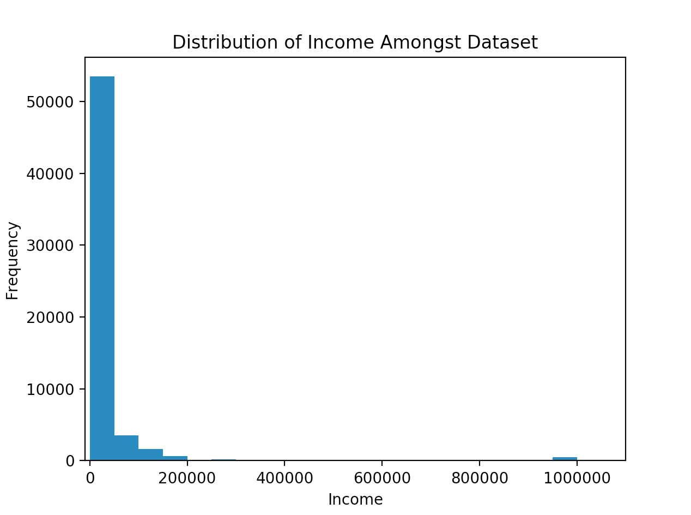
Print(list(df)) returned a list of all labels, including drug usage, income, and education. So I decided to print each of their value_counts().
This is the histogram for income level against frequency.. There is clearly an underwhelming amount of millionaires.
Some things to note include the skewed to the right data and the fact that almost all of the dataset is below 100,000.
How it was created: Using matplotlib’s plt.hist() function, input the dataframe’s income column and set xlabel, ylabel, and title respectively.
Then call plt.show().
Then get popcorn.

Slide 5
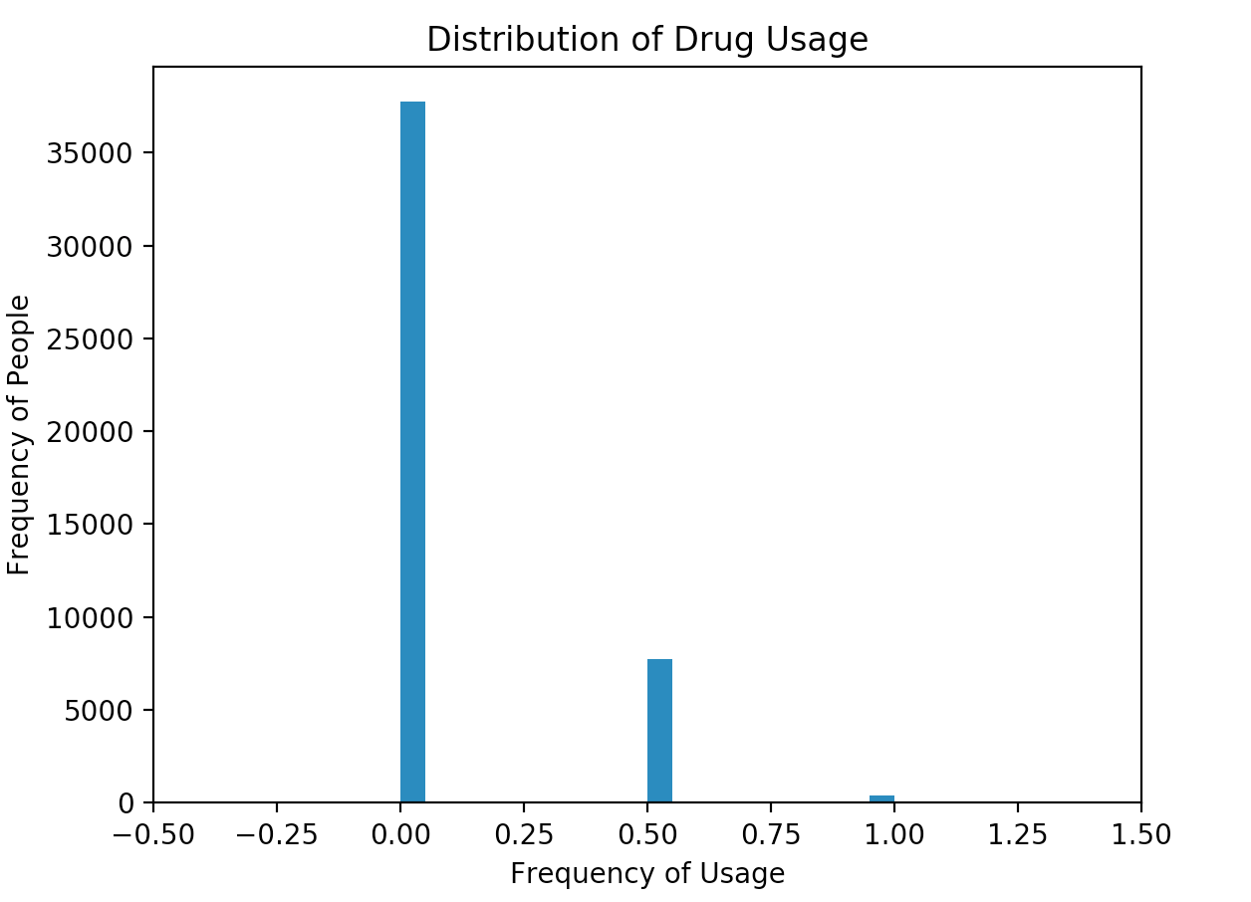
This is the histogram for drug usage level against frequency. Unlike income level, drug levels did not come as a number.
In other words, mapping had to be done. Creating a dictionary that maps each respond to a number (for instance, “never” maps to 0.0), this data to the right is created.
Some things to note include the skewed to the right data and a very similar distribution to the income. In fact, this set of data got me thinking, ‘does doing a lot of drugs determine income?’
Using matplotlib’s plt.hist() function, input the dataframe’s income column and set xlabel, ylabel, and title respectively.
Then call plt.show().
Then get burnt popcorn.

Slide 6
Question Formulation~

Slide 7
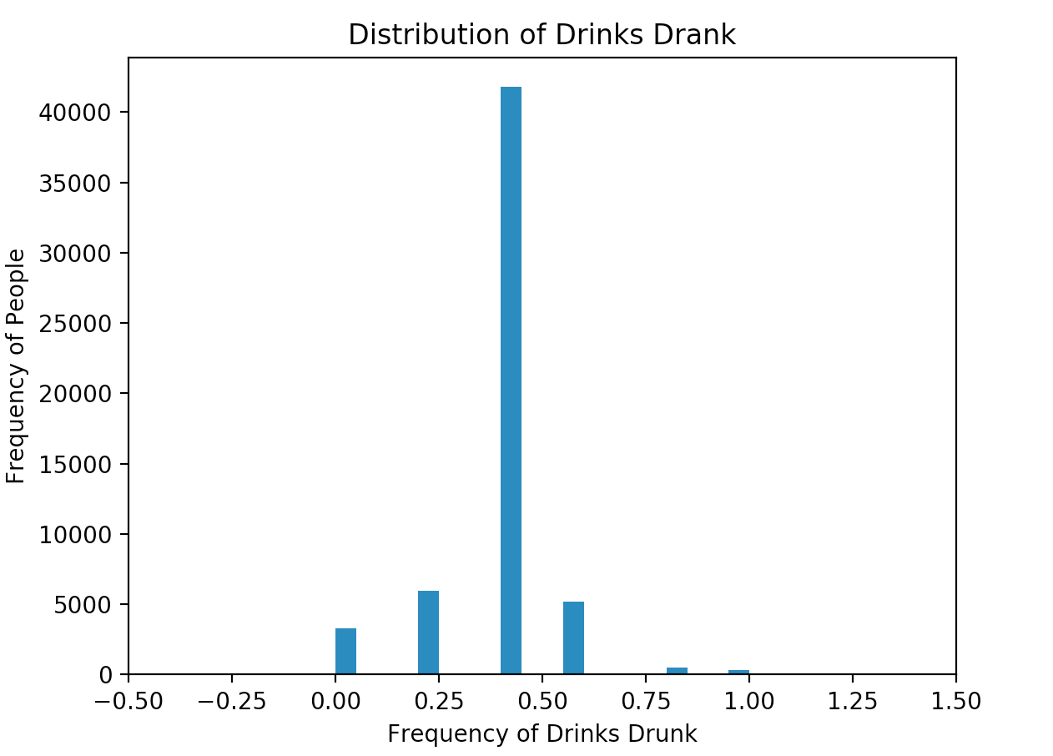
Through the dataset explorations, I’ve come to realize something. Drug usage (alcohol, smoking, .etc.) and Income level had very similar distribution shapes.
Does this mean that those that are at one end of any of those features is at the end of all of them?
To what extent is Income determined by drug usage? Does high usage correlate to high income, as there are very few individuals in each categories?
Also to ensure that said individuals are legal in doing drugs, I also decided to include age and height into the mix when calculating to what extent income can be determined by those factors. And education and status, because studying can be ‘drug like’ and so is dating.

Slide 8
Augmentation Normalization~

Slide 9
One example of augmentation: Education Level
This maps the text to the respective number based on level of education and its status.
Once the final features to consider are chosen (income - label, drugs, status, age, height, education) (chosen to better augment the question of income through usage of drugs in tandem with other ‘drugs’ like studying or dating), now the data must be augmented into a usable form, and then normalized.
This is done by using dictionaries and using the dataframes’ .map() function.
 | High | College | Masters | PhD
Completed | 0.2 | 0.6 | 0.8 | 1
Progress | 0.1 | 0.4 | 0.7 | 0.9
Dropped | 0.05 | 0.3 | 0.65 | 0.85
education_mapping = {“high school” : 0.2, … , “med school”: 1}
Df[‘education_code’] = df.education.map(education_mapping)
This produces the column education_code inside the dataframe that uses the table above to create a numerical indicator of the education label of the individual.

Slide 10
status_mapping = {"single": 0, "available": 0, "seeing someone": 0.5, "married": 1, "unknown": 3}
df["status_code"] = df.status.map(status_mapping)
df = df[df['status_code'] < 2]
This produces the column status_code inside the dataframe df.
The last line of code is utilized to eradicate all the unknowns as they are like NaN.
A simpler example: Status!
Status | Status_Code
Single | 0
Available | 0
Seeing Someone | 0.5
Married | 1
Unknown | 3

Slide 11
data = df[["income_50k", "drugs_code", "status_code", "education_code", "age", "height"]]
x = data.values
minmax_scaler = preprocessing.MinMaxScaler()
x_normalized = minmax_scaler.fit_transform(x)
data = pd.DataFrame(x_normalized, columns=data.columns)
data = data.dropna()
This normalizes the data.
This is necessary as the income for instance goes up to 100,000 while status stays at 1, causing income to be much more important than status. Normalization diminishes this problem to nothing.

Slide 12
Classification Methods~

Slide 13
Classification Preparation
The question was what parts of income can be determined given the data?
But Classification cannot come up with its own income, but can classify data based on previous labels.
I decided 50k was a good center point and proceeded to figure out if the classification algorithms can effectively classify data as a 50k+ earner or a 50k- earner.
A new column, income_50k, was thus born.

Slide 14
Classification Method 1 - Naive Bayes
Naive Bayes Classifier uses the Bayes’ Theorem to make predictions!
It is simple in the sense that there is no pre-set variables that need to be tuned for, but after fitting, the model can be used right away.
In exchange, the predict values must be part of the dataset somewhere, or else this classifier does not work.

Slide 15
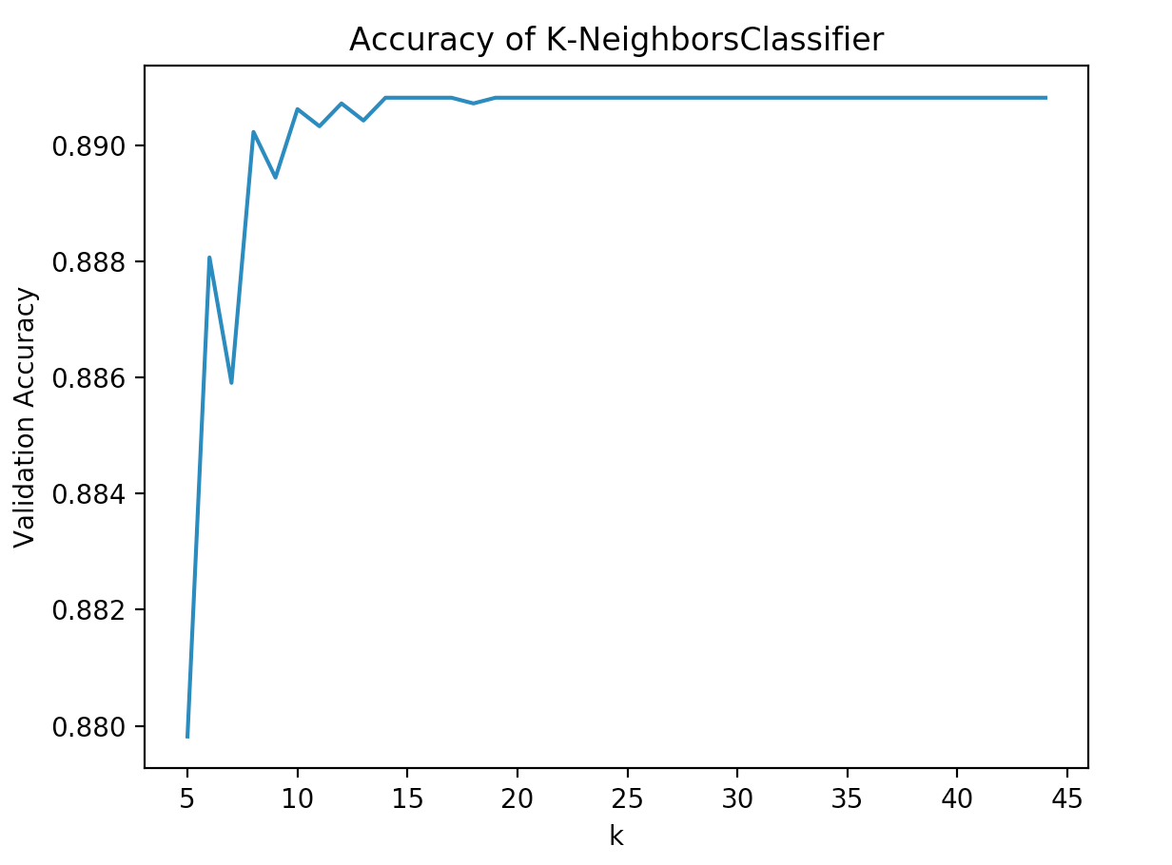
Classification Method 2 - K-Neighbors Classifier
The K - Neighbors Classifier returns the label that is found in the most points in the group of k nearest neighbors of the predict value point.
The process of figuring out the optimal k is very long. Testing values of k and finding it that way can take minutes!
To the right is an image depicting the accuracy rate for various values of k. In this scenario, I put 8 as an optimal k value.

Slide 16
Comparison
Naive Bayes | Comparison Factor | K-Neighbors Classifier
0.01876 s | Time Taken | 90.097 s (finding optimal k) 1.934 s
88.86% | Accuracy | 89.02%
Very Simple | Simplicity (See Respective Slides) | Somewhat simple - augmentation process may take a long time
While KNN does have the flexibility to compare different k values, in this testing chamber the enhanced accuracy of 0.16% is probably not worth spending 90+ seconds on.
I mean, unless you like sitting there, waiting for the training process to finish.

Slide 17
Regression Methods~

Slide 18
Regression Method 1 - Multiple Linear Regression
Linear Regression works by getting each feature and finding the line of best fit. Afterwards, each of them are used, when the training point is come, to find the point on the best fit line that corresponds to each of the features to return a value that is predicted by this algorithm.

Slide 19
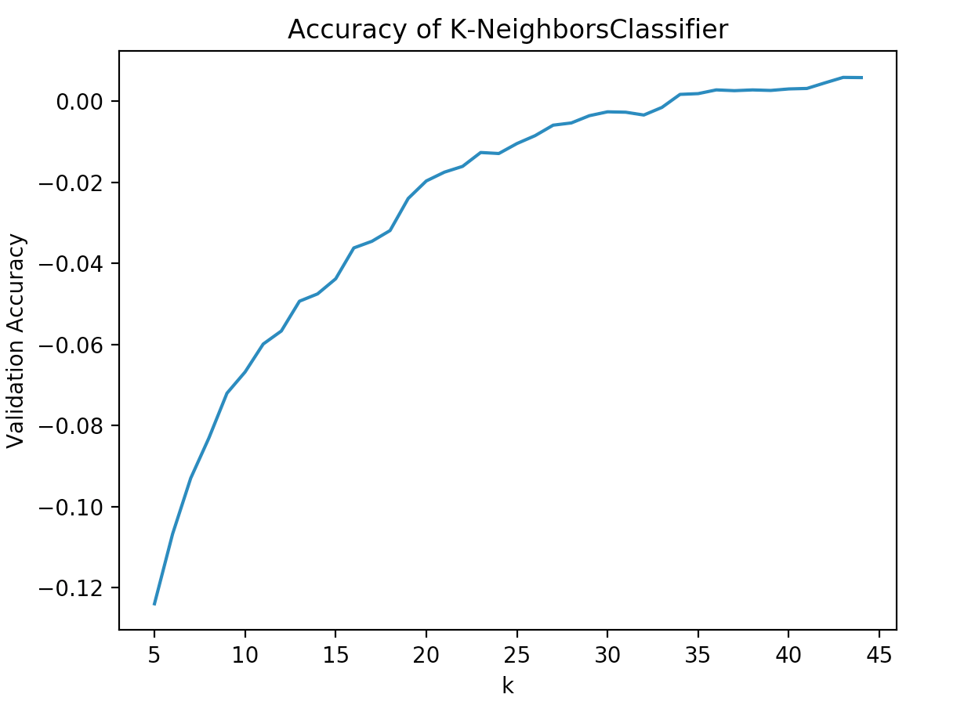
Regression Method 2 - K-Neighbors Regressor
The K - Neighbors Regressor returns the value that is the average of the k nearest neighbors of the predict value point.
The process of figuring out the optimal k is very long. Testing values of k and finding it that way can take minutes!
To the right is an image depicting the R^2 rate for various values of k. In this scenario, I put 34 as an optimal k value.
Accuracy here indicated R^2, or how close the values are to the true values. As the coefficient of determination values are extremely small, this indicates that the KNR algorithm is not doing good at all for this dataset. Not impressive at all.

Slide 20
Comparison
Multiple Linear Regression | Comparison Factor | K-Neighbors Regressor
0.01182 s | Time Taken | 101.62 s (finding optimal k) 2.213 s
0.0099 | R^2 | 0.0017
Simple | Simplicity (See Respective Slides) | Somewhat simple - augmentation process may take a long time
While KNR does have the flexibility to compare different k values, in this testing chamber the worse coefficient of determination is definitely not worth spending 100+ seconds on.

Slide 21
Conclusions/Next Steps/More Burnt Popcorn~

Slide 22
Conclusions
While the Classification dataset did yield success, the regression section was a complete bust. Perhaps that is because the few 1,000,000 outliers completely outweigh the remaining datas which are below 150,000. So the next time I would run this, I would cut out those massive outliers and focus on the data that really is important instead of gigantic outliers.
The classifiers can successfully answer the question of ‘can a person be identified as having an income of 50k+ or not based on age, height, drug usage, education, and status’ with an accuracy of around 89%. While this is not 95% which is the statistically significant threshold, it is still very good.
On the other hand, the regressors tasked with the question of ‘predicting income based on the above factors’, for the time being, is not succeeding. But if the outliers are removed, perhaps the coefficients of determination will increase!

Slide 23
Next Steps
Remove Outliers!
Get more information on education, age and drug used.
Education - there is a huge difference between 1st and 4th grade in college, for instance. That can really affect income.
Age - 23 years and 1 day old and 23 years and 364 days old. The latter has a 363 days head start, which could cause slight alterations in the data.
Drug used - perhaps an individual using alcohol does more work than an individual using cigarettes?
Other data I’d like to have:
Sleep time - urban myth that those who sleep little are in really good schools and thus make a lot of money
Level of job held - the current job categories can be broad. A senior engineer and a newbie are probably not going to be paid the same.

Slide 24
The End!
“Good Luck and Have Fun” - Codecademy

